Slide 1
Harder, Better, Faster, Stronger
Semi-Auto Vulnerability Research
Notes:
Industrialization
Not fuzzer
Not Tools
Ford care analogy
Unique snowflake / pile of bugs on a thumb drive
Every bug a BMW ☺ mass produced, worth 40k, makes someone very happy

Slide 2
Professional Vulnerability Research
Finding bugs is not the problem
  Fuzzing works
    Microsoft found over 1800 bugs in Office 2010
      http://blogs.technet.com/b/office2010/archive/2010/05/11/how-the-sdl-helped-improve-security-in-office-2010.aspx
    280 bugs found in Mozilla JavaScript using JSFunFuzz
      https://bugzilla.mozilla.org/show_bug.cgi?id=jsfunfuzz
Tooling is not the problem
  Distributed fuzzing
  Crash analyzers
Lack of intelligent workflow is the problem
Notes:
Have to explain the difference between dumb and smart fuzzing here. These are smart fuzzers, they took a long time to make and a long time to run. What if there was a way to get your cake and eat it too, applying “workflow” to dumb fuzzing can improve its odds.

Slide 3
Main Goal
Develop an effective workflow and toolset for fuzzing and triaging vulnerabilities in a production environment
Notes:
Production Environment – not software dev – want to sell bugs, or keep munitions depot full.
Exploits (bugs) are the commodity we sell
Based on exploit ninja team size, keep them busy all the time with bugs that don’t take “too long” to exploit.
“Maintain a consistent flow of reliably exploitable vulnerabilities”
I think we should break this down a bit. The tools we’re supplying do not help you write reliable exploits yet.

Slide 4
Ancillary Goals
Primary
  Determine cause and exploitability
  Human time efficiency
Secondary
  CPU efficiency
  Ease of use
Notes:
Exploit output: I can keep sploit writers busy easily by giving them very difficult to exploit bugs over and over – not good; we want to have them be busy, also have a good output
CPU time: not nearly so important, throw hardware at it – still, we don’t want to redo work! Don’t do unnecessary work!

Slide 5
Process Breakdown
Attack Surface Analysis
Input Selection
Fuzzing
Triage
Notes:
Triage needn’t be tied to fuzzing effort! Main idea of the day: separate triage from your fuzzing effort.
Break up fuzzing into test generation, and test execution

Slide 6
Keys to Fuzzing Smartly
Input selection
  Most important factor in timely bug discovery
  Time management
Automation
  SIMPLE Distributed fuzzing
  Crash analysis
  Bucketing
  Confidence Rating
Notes:
KEYS TO THE FIRST THREE STEPS IN THE PREVIOUS SLIDE: Fuzzing isn’t something you do actively. You want to kick it off and forget it. Should be SIMPLE to add systems/programs/inputs/tests

Slide 7
Keys to Smart Bug Triage
Crash selection
  Select for understanding
  Crash database
  Bug classes
Program flow analysis
  Code coverage
  Input Mapping
  Taint Analysis
Notes:
Triage and fuzzing are totally disjoint. Key to time management is crash selection. What is relevant to your interests.
KNOW WHAT TO TRIAGE QUICKLY

Slide 8
Input Selection
Attack Surface Analysis
  Determine which areas of the code are reachable from external inputs
Template code coverage
  Determine what areas of code are exercised by different templates
Rank templates based upon coverage of targeted code or overall attack surface
Notes:
Ancillary goals: human time, cpu time, ease of use

Slide 9
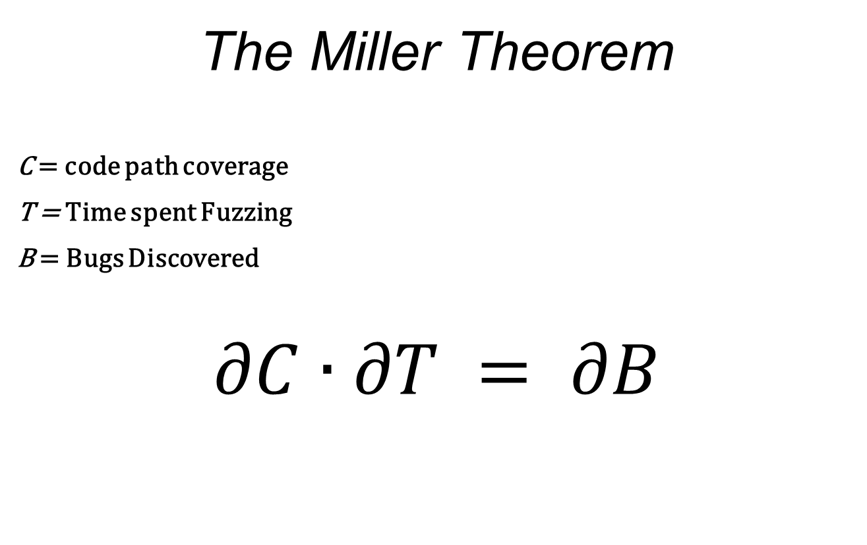
Fuzzing
The Miller Theorem
C = code path coverage
T = Time spent Fuzzing
B = Bugs Discovered
$$∂C∙∂T = ∂B$$
Notes:
More time? More bugs. More code path coverage? More bugs.

Slide 10
Fuzzing
Obey the Miller Theorem
  Create inputs to maximize coverage
  Create the framework to maximize uptime
Generation vs. Mutation
  If you can, do both!
  Mutation is cheaper, still works
Do as little work as possible
  Re-do as little work as possible
Notes:
How to obey: set up input selection to maximize code coverage, create framework to make it easy to maintain uptime, add resources
Talk about generation time sink, lots of people time, unfocused cpu time; mutation is fast / cheap – don’t need to find ALL the bugs
Ancillary goal: people time efficiency – mutation as long as it works – no reason not to mutate!

Slide 11
Fuzzing
Test Execution
Data Collection
Retesting
Notes:
People see fuzzing as a single thing. Ongoing process. “I fuzzed X” makes no sense. Reeval, find new attack surface, refuzz! Automate that! Bindiff, store diff graphs, they become your new attack surface.

Slide 12
Fuzzing – Test Execution
Watch your tests well
  Embedded custom debugger
  Be able to gather needed data at crash time
  Make use of debugging technologies
  Be able to avoid invalid exceptions
Distribute your tests
  Centralized management
  Make it easy to add nodes
Notes:
Don’t redo work you’ve already done (running tests) - running in a debugger doesn’t slow down a test.
Ignore / catch handled issues, use debugging technologies (pageheap)
Tests are atomic. Distribute. Make it easy. Enlist your sales force desktops.

Slide 13
Fuzzing – Data Storage
Use a database!
  Store lots of data over time
  Easily searched
What to store
  Store what you need for crash selection
  All crash information
  Software versioning information
    Binary diffs
Notes:
Fuzzing is ongoing. Storage is cheap. Store your data forever.
You’ll have to pull crashes for triage some day – store everything that will help you to decide what to triage, when – store everything that isn’t costly
Store coverage graphs for base files, attack surface graphs, etc

Slide 14
Fuzzing - Retesting
Maintaining a good database allows:
  Automated retesting of modified code paths
  Automated retesting of crashes in modified code paths
Track bug life across software versions
  A bug which lives through a nearby patch can have a long shelf-life
    MS08-067 and MS06-040
    ANI
Notes:
Just store your base file and it’s code path coverage graph. Auto-pull inputs that will test changed paths. Kickoff retests when a new diff is imported.

Slide 15
Triage – Crash Selection
Which crashes should receive priority?
What properties make crashes more exploitable?
  Knowledge! Familiarity!
Crash database
  Vulnerability properties
  Searchable crash criteria
Notes:
Leaving crash creation. Two groups. One who does just triage / possibly exploitation. Mine database for bugs you understand. Dowd, NPD in actionscript. What if you threw them all out? Need a crash with certain properties. Check the database.

Slide 16
Triage – Crash Selection
Exception Analysis
  Determine level of access exception grants user
Bug Class Identification
  Difficulty of exploitability varies by bug class
  Custom architecture problems
    Custom memory allocators

Slide 17
Triage – Program Flow Analysis
Abstract a program into flows
  Code execution
  Data dependency
Code Coverage
  Block hit trace for path to exception
  Build a graph of program execution
  Augment static program graphs

Slide 18
Triage – Program Flow Analysis
Input Mapping
  Trace APIs or System Calls that perform I/O
  Mark data copied from external sources into memory
Taint analysis
  Follow input through the execution of the program
  Determine where the bytes of the crash originated
  Potential for exploit and signature generation

Slide 19
Triage – Program Flow Analysis
Visualization
  Provides a graphical representation of program structure and execution paths
  Visualization allows overlaying multiple graphs and datasets using visual cues
  Converting data to a visual problem allows rapid understanding of large datasets

Slide 20
Moflow

Slide 21
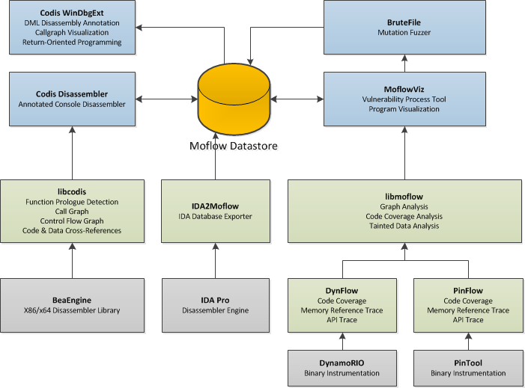
Notes:
Ancillary goals: human time, cpu time, ease of use

Slide 22
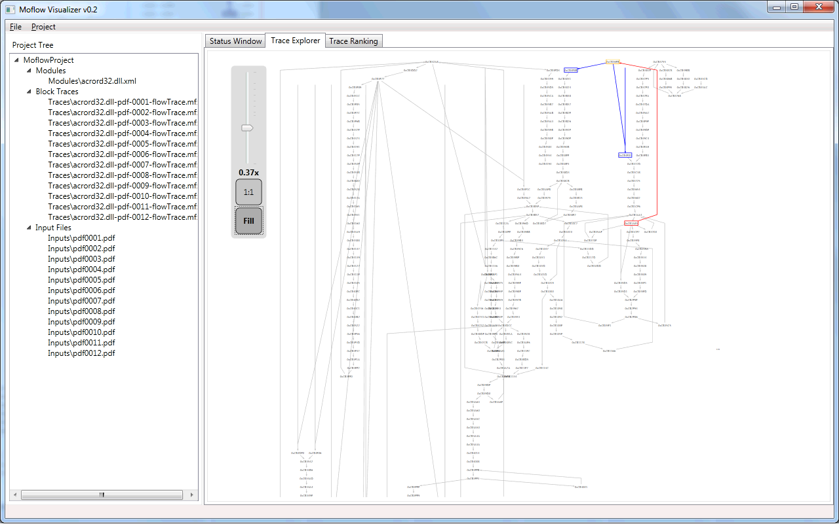
[Moflow.png]
Notes:
Ancillary goals: human time, cpu time, ease of use

Slide 23
Moflow: Input Selection

Slide 24
Input Selection - Requirements
Attack Surface Analysis
  Call graph analysis
Template code coverage
  Dynamic tracing
Template ranking
  Coverage graph analysis
Notes:
Do not explain these yet, upcoming slides

Slide 25
Attack Surface Analysis
Obtain call graph
  IDA2Moflow.idc
  LibCodis
Define APIs that are data entry points
 | Input Source | I/O API
File | NtOpenFile() NtCreateFile() SYS_Open() | NtReadFile() NtWriteFile() SYS_Read() SYS_Write()
Network | connect() accept() | send() recv()

Slide 26
Attack Surface Analysis
Determine reachability graph from each API
δ-wavefront ← RootSet
closure ← 〈〉
While nonEmpty(δ-wavefront) Do
wavefront ← oneStep(δ-wavefront)
δ-wavefront ← wavefront − closure
closure ← closure ∪ δ-wavefront
End While
Return closure
δ-wavefront Algorithm – Qadah et al.
Notes:
The δ-wavefront algorithm’s theoretical time complexity is linear in the number of edges in the graph
Builds a worklist of items 1 node away from current set, each node not in previously analyzed set is added to worklist

Slide 27
Template Code Coverage
Dynamic Tracing
  Instrument each basic block in a program
  Efficiently record execution order of all blocks
Implementation - PinFlow
  Program tracer written as a PinTool
  Hook on block cache creation
  Inject instructions into cached code blocks
  Callback function writes binary struct to ringbuffer
  Ringbuffer flushed when full and on program exit

Slide 28
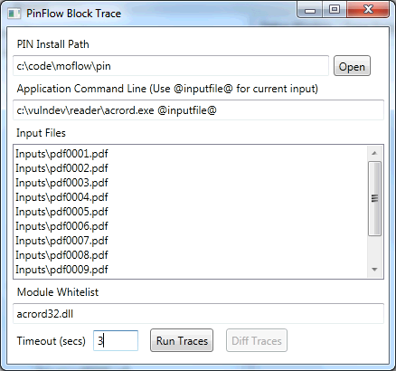
Template Code Coverage
Moflow Visualizer PinFlow Trace Launcher

Slide 29
Template Code Coverage
Advantage – Speed
  PIN is much faster than traditional breakpoint or trap based solutions
11.57 times faster!
7zip Benchmark Test
Block Tracer | Time (sec)
Process Stalker | 20.48
PinFlow | 1.77

Slide 30
Template Prioritization
Select functions for attack surface
Calculate reachability to create attack surface graph
Rank stored traces by number of nodes hit in attack surface graph
Notes:
Explain, screenshot next

Slide 31
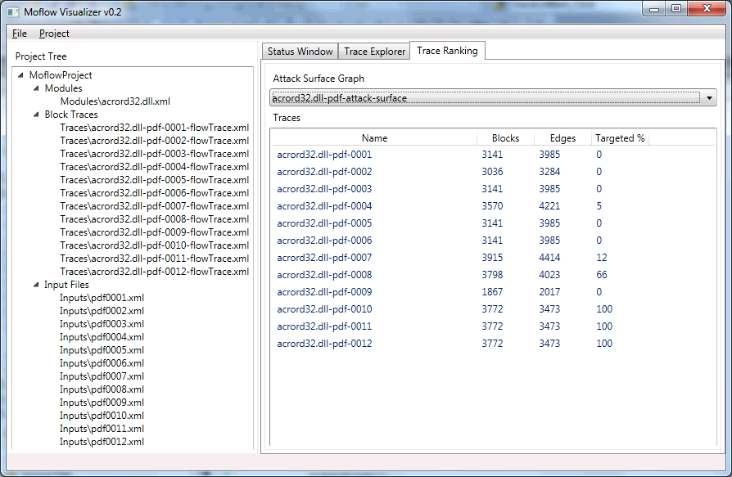
Template Prioritization
[TraceRank.png]

Slide 32
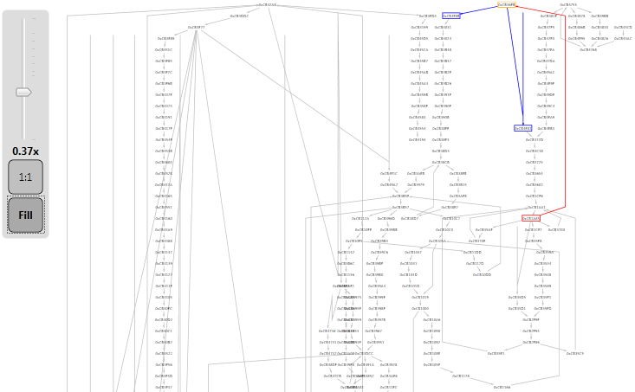
Graph Visualization
Moflow Block Trace Graph Visualization
[Graph 1]

Slide 33
Fuzzing Automation

Slide 34
Fuzzing Automation
Distributed Fuzzing
Fuzzer Management
Data Gathering
Crash Mining
Notes:
Create a process framework around your fuzzers. Make the fuzzer interchangeable.

Slide 35
Distributed Fuzzing
Tests are small and atomic
  Distribute simply
  Make it easy to add systems
  Easy to add tests
Centralized Management
  Aids in speedy addition of hardware
Notes:
Obviously want to distribute. Necessitates centralized management. Store scripts, binaries, input generation data, etc. For generation, maybe you just pass created inputs out for testing

Slide 36
Fuzzer Management
Customizable yet simple
  Ignore first chance exceptions?
  Add debugging technologies?
  Max test case timeout
Ease of use is key
  Quick recovery for dead hosts
  Quick addition of new hosts
  Centralized management w/ database
Notes:
Manage your test cases. Don’t just collect crash dumps. Otherwise, you’re redoing work. Not conducive to continuous fuzzing. No stages in continuous fuzzing until we get to triage, after selection. Asynchronous!

Slide 37
Fuzzer Management
Jobs are held in the central DB
  Job details passed to workers
  Test cases are generated by workers as needed
  Successful crashes are returned to the DB with details
Test cases are wrapped with a custom debugger
Data is returned to the central DB

Slide 38
Basic Worker
Job Collection (curl -> sql database)
Fuzzing Engine (anything you like!)
CPU Monitor (WBEM)
Debugged Test Thread (dbgext)
Data Collection (Codis, dbgext)
Data Reporting
(curl -> sql database)
Notes:
Get scripts, base files, configs, etc; Use whatever mutator / generator you’d like; Run the test case, monitored; collect data, report data;

Slide 39
Data Gathering
Store what you must
  Bucketing
  Categorization
  Indicators of Exploitability
Store what you have
  Why redo work?
  Can’t know what you may need
Store it smart
  Database!
Notes:
Things we need for selection; bucketing data, some categorization, enough data to eyeball a crash – changes over time
Things we get for free; might as well store it because what we need to eyeball a bug may be different in 6 months
Store it somewhere we can SEARCH.

Slide 40
Crash Mining
Post-crash analysis is performed on crashes deemed “relevant”
Relevant crashes are those which are:
  Familiar to your exploit developers
  Relate to your attacking goals
Relevant crashes are mined as needed from the database with queries.
  What is relevant changes over time.
Notes:
Decide what to triage as it becomes interesting. Mark crashes as checked on a certain date. Narrow your searches. Find the low hanging fruit.
Very cool to exploit bugs people don’t yet understand. But they are “Bad ROI Bugs”

Slide 41
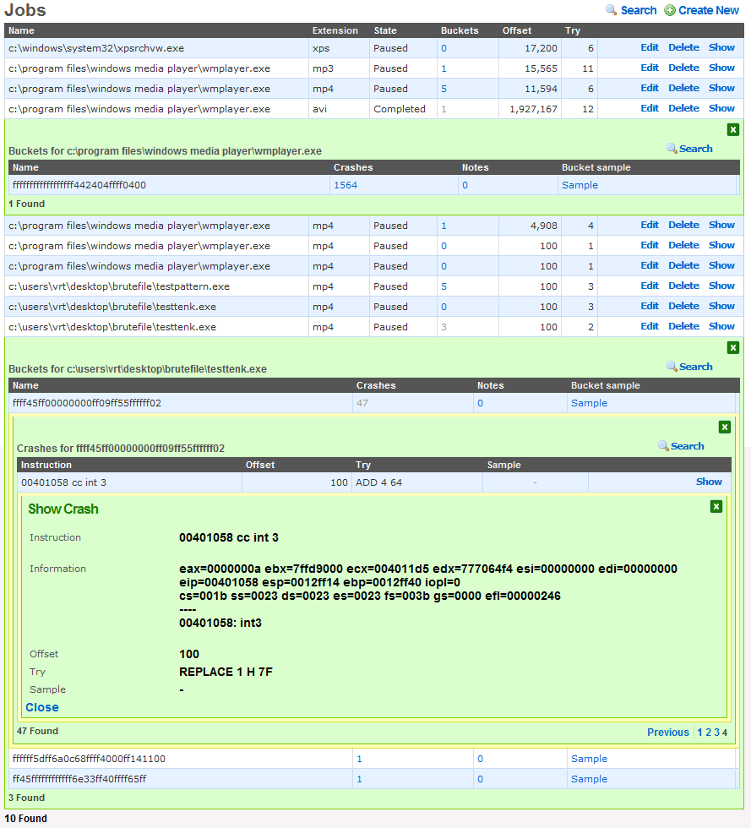
Notes:
Herbert interface – web interface to the centralized database

Slide 42
Moflow: Triage

Slide 43
Triage - Requirements
Exploitability
  Exception information
  Deep Trace
Triggering Condition
  Fuzzer feedback
  Taint analysis
Root Cause
  Graph analysis

Slide 44
Triage - Exploitability
Exception Information
  Brutefile outputs XML data containing exception information
Deep Trace
  Code Coverage
  Attack surface APIs
  Dataflow

Slide 45
Triage - Exploitability
Dataflow
  Once exception is found program is traced using PinFlow to gather instruction level instrumentation
  Blocks are hooked during cache and disassembled to instrument instructions that access memory
  Dataflow callback function records the address and value of each memory read or write
Taint Analysis
  Provides exception analysis functions with information about controlled bytes
  Knowledge of controlled bytes allows more precise analysis

Slide 46
Triage – Triggering Condition
Fuzzer Feedback
  As part of exception analysis data Brutefile includes information about mutation
Taint analysis
  When triaging a bug from input with unknown modifications, perform taint analysis
  Forward taint propagation from memory allocated to stored data from input file will reveal which bytes are referenced in the exception

Slide 47
Triage – Root Cause
Graph Analysis
  Overlay graphs of several deep traces to determine similarity
  If execution trace leading up to the crash is identical but different bytes were manipulated, root cause should be determined
Taint analysis
  Follow tainted data in the exception back to the code location that first influenced the memory location with external data

Slide 48
Moflow: Tools

Slide 49
Console Disassembler
Console interface for libcodis
Static Analysis
  Instruction Disassembly
  Function Detection
  Code and Data Cross-References
  Function Control Flow Graph
  Call Graph
Import IDA2Moflow and .map files

Slide 50
Windbg Integration
CodisExt
  Windbg extension using the engextcpp API
  Utilizes libcodis to extract disassembly graphs and cross-references
  Utilizes Windbg DML functionality to allow a hyperlinked interface for cross references

Slide 51
Windbg Integration
0:000> !codis
[codis] Usage:
[codis] !codis load <moduleName> Load a module into the disassembler engine
[codis] !codis xrefs [functionAddr] Show caller/callees
[codis] !codis callers <functionAddr> Show function callers
[codis] !codis callees <functionAddr> Show function callees
[codis] !codis names Show names in codis database
[codis] !codis dis <moduleName> [functionAddr] Dump disassembly of a module or function
[codis] !codis dot Dump a GraphViz DOT file
0:000> !codis load test
[codis] Loading C:\Vulndev\test.exe
;------------------------------------------------------------------------------
; File Header
;------------------------------------------------------------------------------
; Binary format: 32-bit PE
; Byte Ordering: Little Endian
; Entry Point: 0000130b
; File Size: 112128 bytes
;-----------------------------------------------------------------------------

Slide 52
Windbg Integration
0:000> !codis xrefs
[codis] Function: 00401005 sub_00401005
[codis] xrefs to: 00401149
[codis] xrefs from:
[codis] Function: 0040100a sub_0040100a
[codis] xrefs to: 0040100f
[codis] xrefs from:
--- SNIP ---
[codis] Function: 00411850 sub_00411850
[codis] xrefs to: 00411763
[codis] xrefs from:
[codis] Function: 00411a58 wrapper_RtlUnwind
[codis] xrefs to: 0040e530 00407732
[codis] xrefs from:
[codis] Function: 44cbe836 sub_44cbe836
[codis] xrefs to: 0040e53
0:000> !codis dot
digraph G {
"00401005"
"0040100a"
"0040100f"
"004010c0"
"0040113a"
--- SNIP ---
"00401076" -> "0040100a"
"00401058" -> "0040113a"
"0040104b" -> "004010c0"
"0040100f" -> "00401070"
"0040100a" -> "00401030"
}

Slide 53
Windbg Integration
0:000> !codis dis test 00402eea
00402eea |
........ | ;;;;;;;;;;;;;;;;;;;;;;;;;;;
........ | ;;; S U B R O U T I N E ;;;
........ | ;;;;;;;;;;;;;;;;;;;;;;;;;;;
........ | sub_00402eea: ; xrefs: 0x00402f68 0x00402f31 0x004015f7
........ | 6a 08 | push byte 0x8 ;
00402eec | 68 60 a2 41 00 | push dword 0x41a260 ;
00402ef1 | e8 32 fd ff ff | call <sub_00402c28> ;
00402ef6 | e8 2e f9 ff ff | call <sub_00402829> ;
00402efb | 8b 40 78 | mov [eax+0x78], eax ;
00402efe | 85 c0 | test eax, eax ;
00402f00 | 74 16 | jz 0x402f18 ;
00402f02 | 83 65 fc 00 | and dword 0x0, [ebp-0x4] ;
00402f06 | ff d0 | call eax ;
00402f08 | eb 07 | jmp 0x402f11 ;
00402f0a | 33 c0 | xor eax, eax ;
00402f0c | 40 | inc eax ;
00402f0d | c3 | ret ;
00402f0e | 8b 65 e8 | mov [ebp-0x18], esp ;
00402f11 |
........ | loc_00402f11: ; xrefs: 0x00402f08
........ | c7 45 fc fe ff ff ff | mov dword 0xfffffffe, [ebp-0x4] ;
00402f18 |
........ | loc_00402f18: ; xrefs: 0x00402f00
........ | e8 46 48 00 00 | call <sub_00407763> ;

Slide 54
IDA Integration
IDA2Moflow.idc
  Dumps static program call graph
    Module
    Functions
    Calls
  Works on all versions of IDA
Useful to overcome current limitations in static analysis provided by libcodis

Slide 55
Questions?

Slide 56
Email: rjohnson@sourcefire.com
richinseattle@gmail.com
Twitter: Richinseattle
Email: lgrenier@sourcefire.com
pusscat@metasploit.com
Twitter: Pusscat
Special Thanks to Chris McBee!

Slide 57
Extra Slides

Slide 58
Template Code Coverage
Dynamic Tracing
Implementation
  Program tracer written as a PinTool
  Designed for Win32 platform
  Function and Block hooking for Code Coverage
  System call hooking for I/O*
  Memory reference trace*
  Logging to standardized format

Slide 59
Static Analysis
Instruction Disassembly
Function Detection
Code and Data Cross-References
Function Control Flow Graph
Module / Program Call Graph

Slide 60
Instruction Decoding
BeaEngine 4
  Multi-Architecture
    x86 / x64
  High performance
    [stats]
  Actively developed
    [stats]

Slide 61
Function Detection
Prologue Detection
  [Image of prologues]
Static call targets
  [show dynamic call vs static call]

Slide 62
Code and Data Cross-References
Disassembly of functions results in extraction of CALLs, JMPs, and static data references
[image goes here]

Slide 63
Function Control Flow Graph
Break a function into basic blocks
  JMP
  CALL
  RET

Slide 64
Module / Program Graph
Enumerate function cross references
Support loading multiple modules for inter-modular call graph

Slide 65
Dynamic Analysis
LibMoflow
  High level program analysis library in C#
  Code Coverage Analysis
  Trace Differencing
  Graph Analysis
  Tainted Data Analysis

Slide 66
Code Coverage Analysis
Augment graph from static analysis with code coverage
Trace Differencing
CrashViz
  Program Graph
  Trace Overlays

Slide 67
Trace Differencing
Describe algorithm here

Slide 68
Graph Analysis
Loop Detection
  Dominator Trees
  etc

Slide 69
File Visualization
Hex and Strucutred Tree Views
Visualize Fuzzer File Mutations and other session metadata
Structure Decoding
  Office Formats (GUT)
  PDF (Only’s lib?)
  FLASH (Patrick/Shong’s lib)

